Slide 1
Cloud Security Monitoring on a Dime Store Budget
Wes Lambert
DEFCON Blue Team Village 2020

Slide 2
Agenda
NSM
Core concepts
Data types
Challenges
Security Onion
Native Facilities for NSM in the Cloud
Automating deployment of NSM in the cloud

Slide 3
NSM – Network Security Monitoring
...collection, analysis, and escalation of indications and warnings to detect and respond to intrusions…
https://taosecurity.blogspot.com/2014/09/a-brief-history-of-network-security.html

Slide 4
NSM – Cycle
Collection
Detection
Analysis
Ref: Applied NSM – Chris Sanders, Jason Smith

Slide 5
NSM - Collection
Most important phase of the NSM cycle
Need data to facilitate detection and analysis!
Can often be the most labor intensive phase, due to coordination amongst leadership, and various technical teams
Can include tasks such as:
Defining where the largest amount of risk resides within an organization
Identifying threats to organizational goals
Identifying/refining relevant data sources
Configuring capture and retention of data (hardware/software/storage)
Ref: Applied NSM – Chris Sanders, Jason Smith

Slide 6
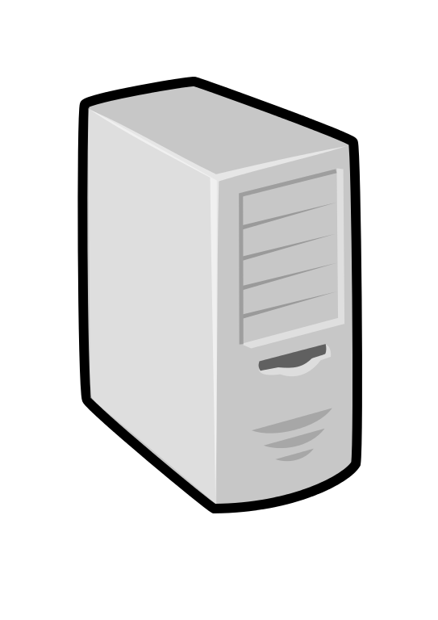
NSM – Collection - Typical Infrastructure
Interwebz
TAP
Server
Sensor

Slide 7
NSM - Detection
Process by which collected data is examined and alerts are generated based upon observed events and data that are unexpected.
Signatures
Statistical anomalies
Most often completed by software
NIDS
Snort/Suricata/Zeek
HIDS
Wazuh/OSSEC
SIEM
Sigma
Built-in correlation

Slide 8
NSM – Analysis
Final stage of NSM lifecycle
Where humans interpret and investigate alert data
Usually involves gathering data from additional sources
HIDS
NIDS
Windows Event Logs/Sysmon
HTTP/DNS transactions
May ultimately include malware analysis

Slide 9
NSM – What it is
Obtaining a copy of each packet traversing the network and forwarding to a sensor for collection and analysis
Mechanism to provide rich, contextual data about interactions between hosts within a monitored computer network or segment
Relatively inexpensive to implement, compared to other methods of security monitoring

Slide 10
NSM – What it isn’t
NSM is not intended to prevent intrusions
Prevention eventually fails
s/prevention/detection/
NSM is not EDR, although can be integrated alongside for greater visibility
NSM is not “continuous monitoring”
NSM == threat centric
CM == vulnerability-centric
NSM is not just having a magic box to find all badness

Slide 11
NSM – Data Types
Full Content Data
Entire conversation between two hosts
PCAP
Extracted Content
Files extracted from network stream
EXEs
PDFs
RARs

Slide 12
NSM – Data Types (2)
Session Data
Details about a particular network session/connection seen between two hosts
Number of bytes
Duration
Connection state
Protocol/service type

Slide 13
NSM – Data Types (3)
Transaction Data
Data about a particular type of network transaction
HTTP
URI/User Agent/Method/etc
DNS
Query/Answers/Response Code
Alert Data
Data generated by an IDS, alerting the user to a particular content match
Ex. Notification for detection of Trickbot Trojan

Slide 14
NSM - Challenges
NAT
Can obscure source/destination addresses
Encryption
Can hamper the ability to see contents of traffic
Throughput
Hardware/performance implications
Privacy
Legal implications

Slide 15
NSM – In the cloud
NSM in the cloud is still a toddler
Some providers provide native mechanisms, while others do not
In the event that a native mechanism is not available, workarounds do exist, but can be difficult to maintain and scale
NSM can be complemented by other sources of telemetry, for a more wholistic approach

Slide 16
NSM – Cloud Challenges
VXLAN encapsulation
We can record it, but can our applications handle it?
Segmentation
Are we able to get the data we need to our sensors?
Ephemerality
Services in the cloud frequently spin up/down
In some cases, no native mechanism for NSM

Slide 17

NSM – Security Onion
Created by Doug Burks in 2008
Free and open source platform for intrusion detection, enterprise security monitoring, and log management
Can be installed from an ISO image or packages on top of Ubuntu 16.04 in minutes
Traditionally fed data from a TAP or SPAN port
Integrated with the Elastic Stack for data enrichment, indexing, and visualization
https://securityonion.net/

Slide 18
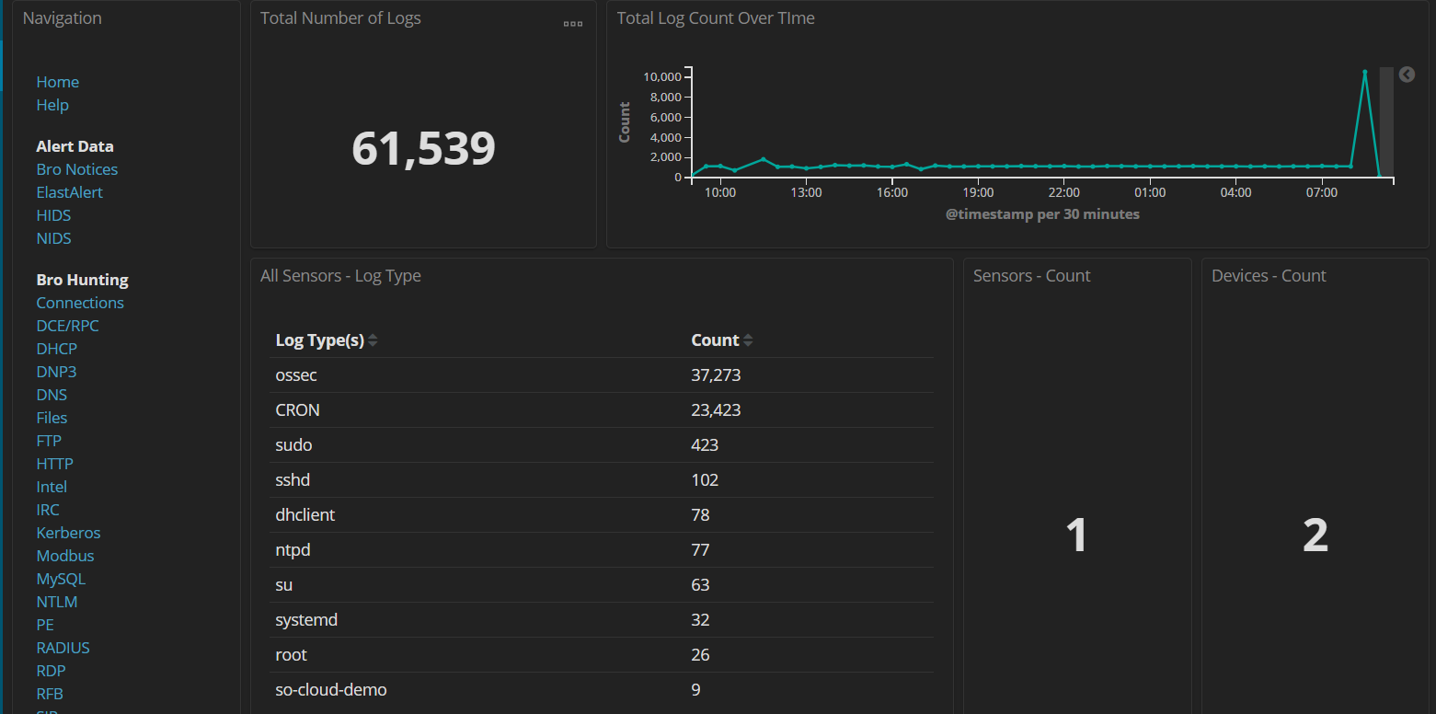
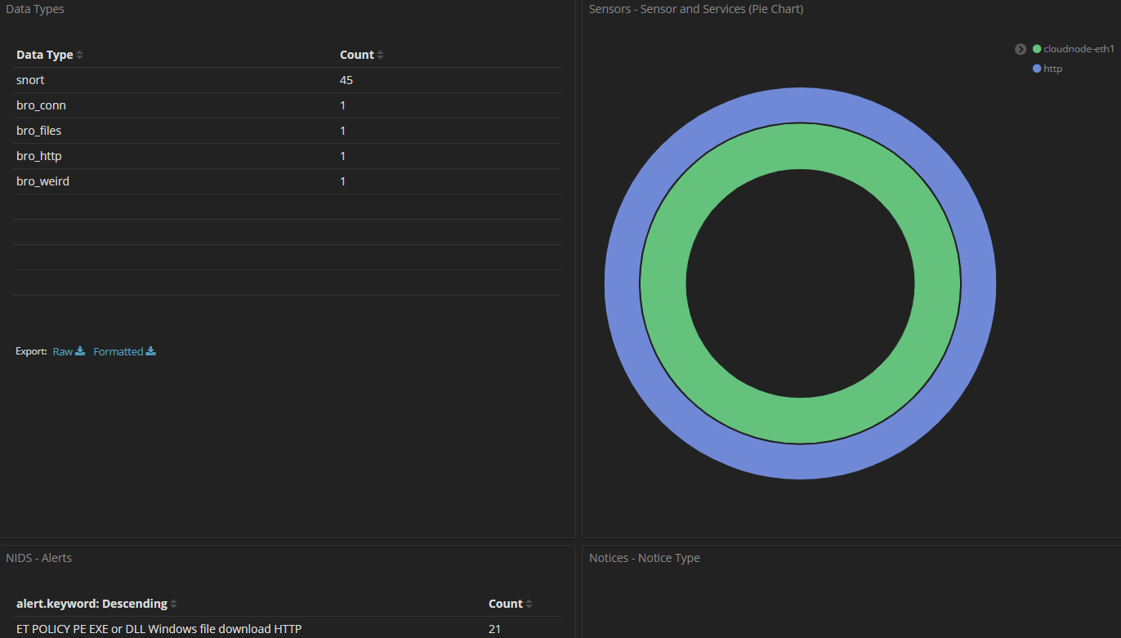
NSM – Security Onion - Overview
https://securityonion.net/

Slide 19
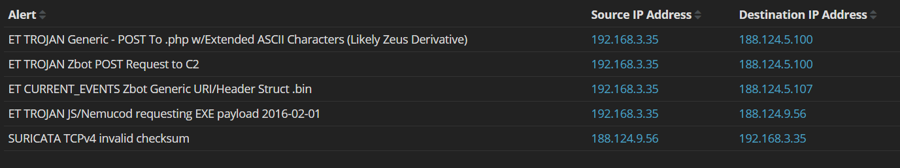
NSM – Security Onion – Alert Data
HIDS/NIDS Alerts
Wazuh/Snort/Suricata

Slide 20
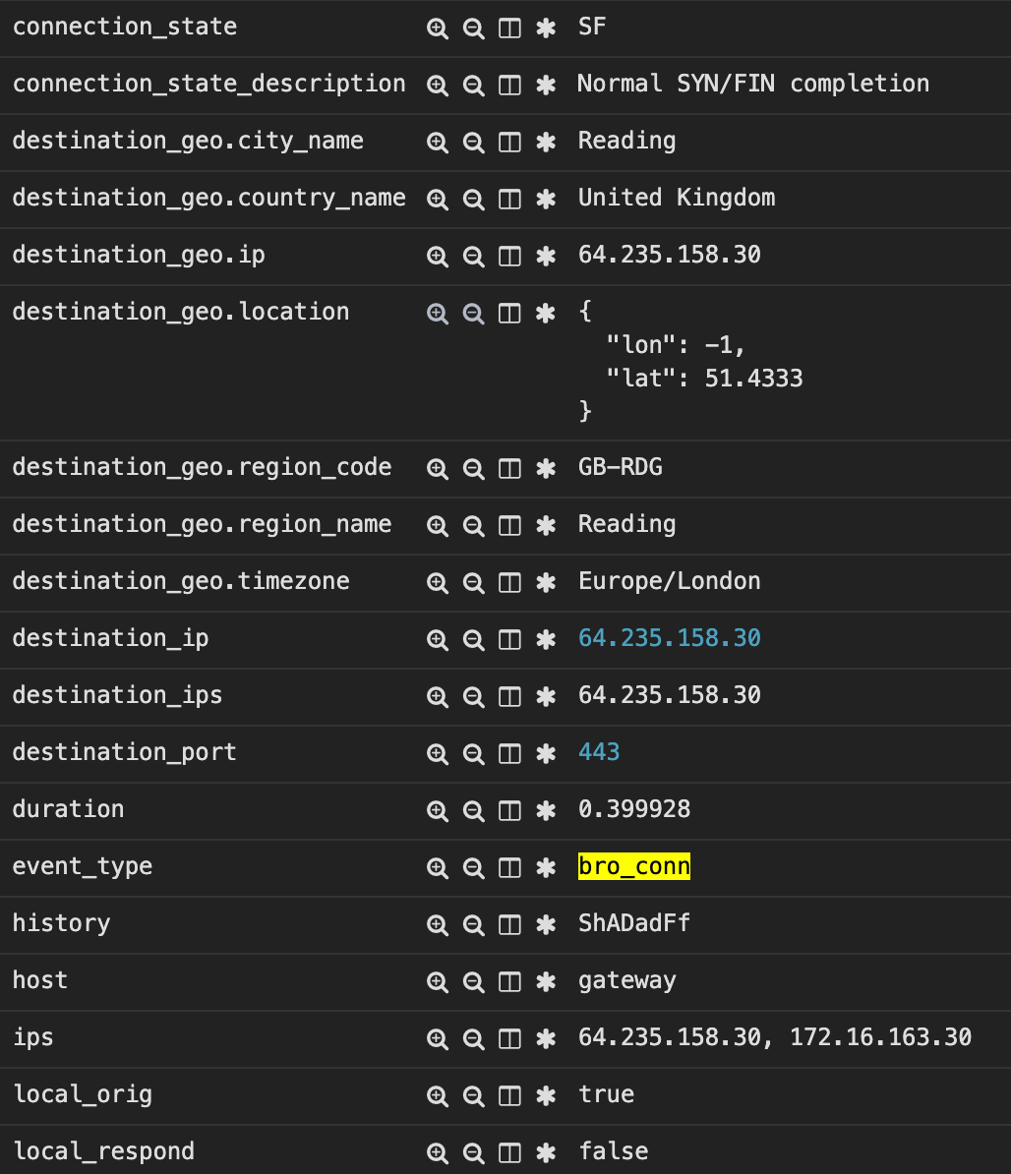
NSM – Security Onion - Metadata
Network Metadata
Bro/Zeek
DCE/RPC
DNS
HTTP
SSL
and much more

Slide 21
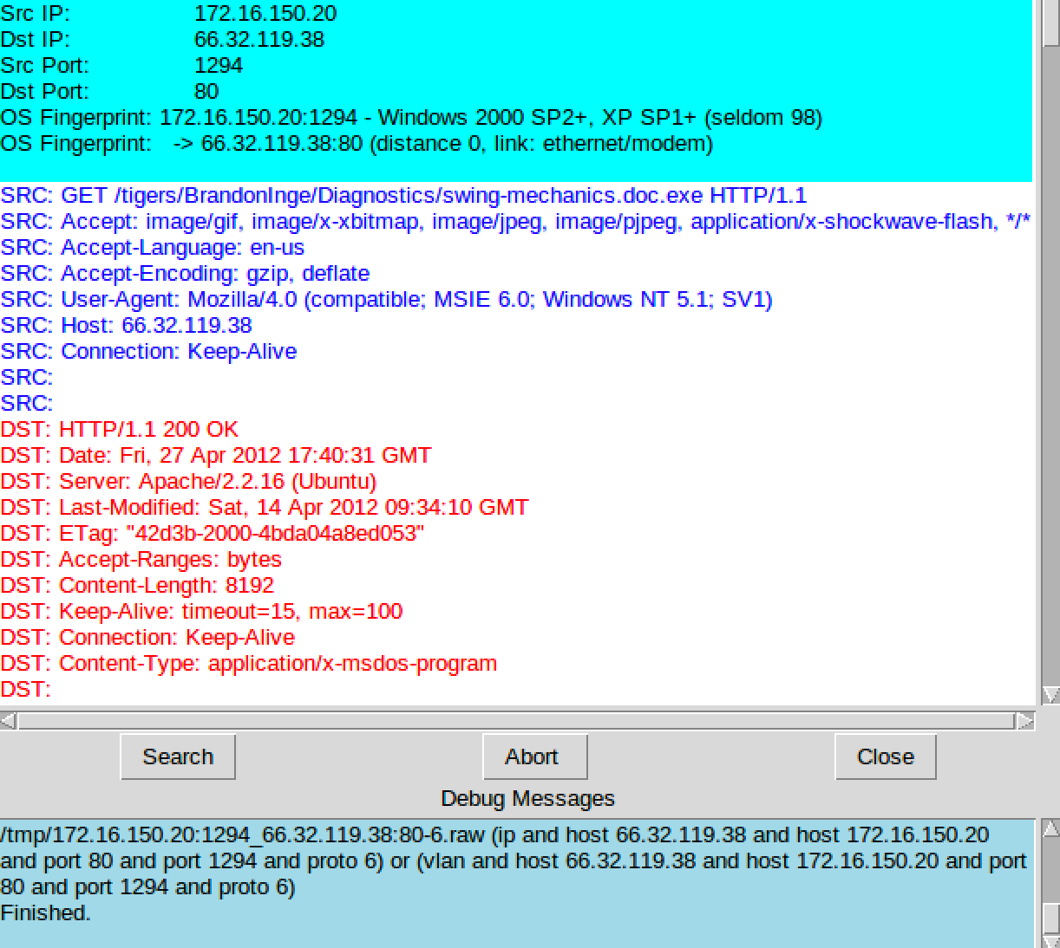
NSM – Security Onion – Full Content Data
Full Content Data (PCAP)
Netsniff-NG
Complete transcript

Slide 23
AWS – Native NSM Capability
Traffic Mirroring
Mirror traffic from source network interface of EC2 instance to target interface
Packets encapsulated and transported via VXLAN
https://docs.aws.amazon.com/vpc/latest/mirroring/traffic-mirroring-how-it-works.html

Slide 24
AWS – Traffic Mirroring Components
Mirror Session
Mirror Source
(ENI)
Mirror Source
(ENI)
Mirror Target
(ENI)
Mirror Filter
Mirror Source
(ENI)

Slide 25
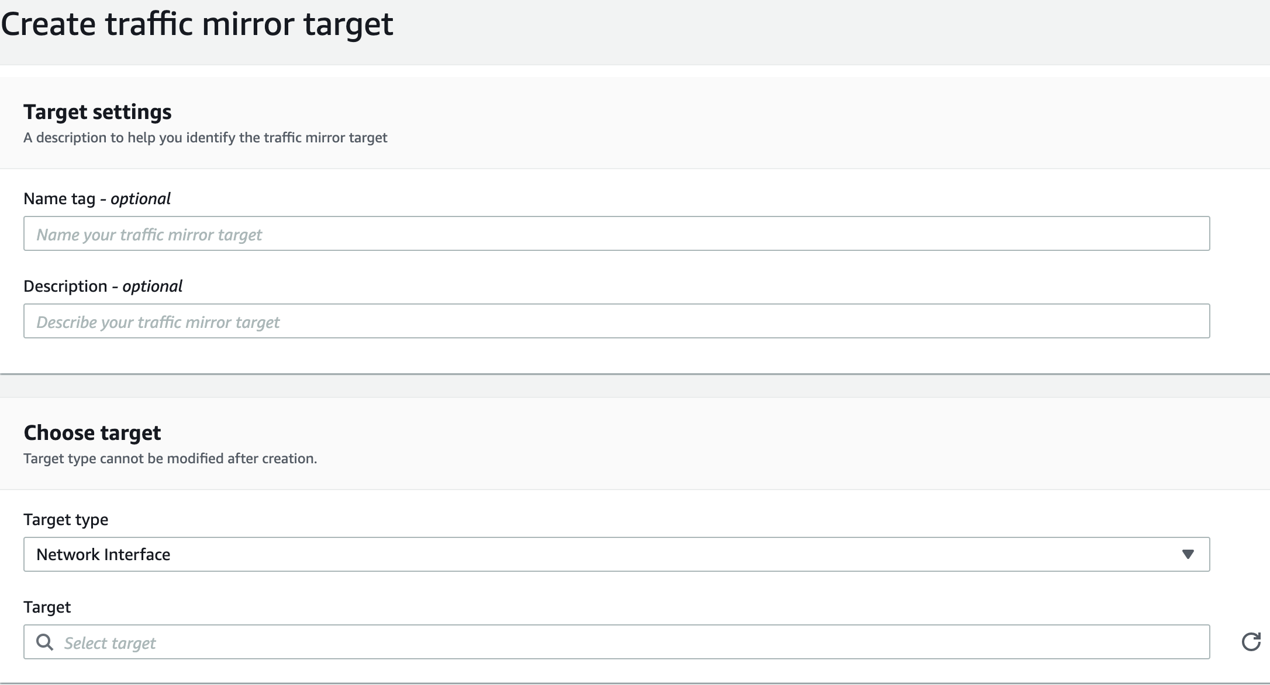
AWS – Traffic Mirror Target
Define the target interface where we would like to send mirrored traffic

Slide 26
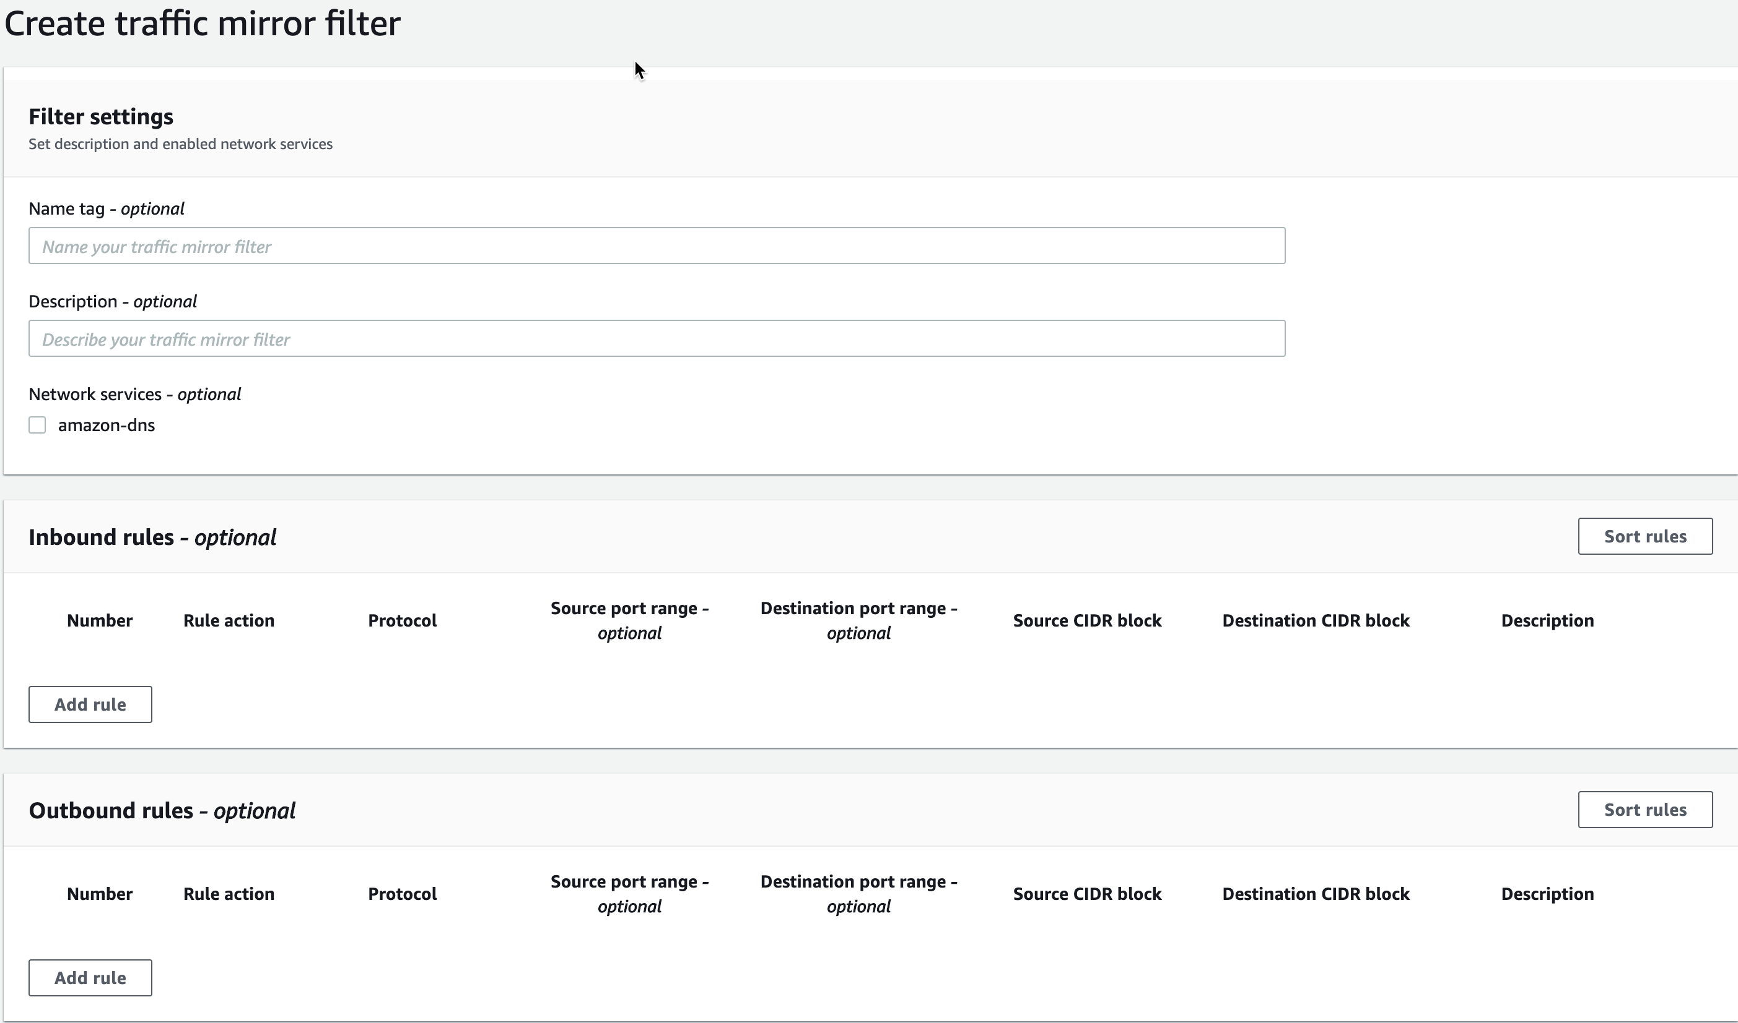
AWS – Traffic Mirror Filter
Define the protocols/traffic to be mirrored
Filter out any unwanted traffic

Slide 27
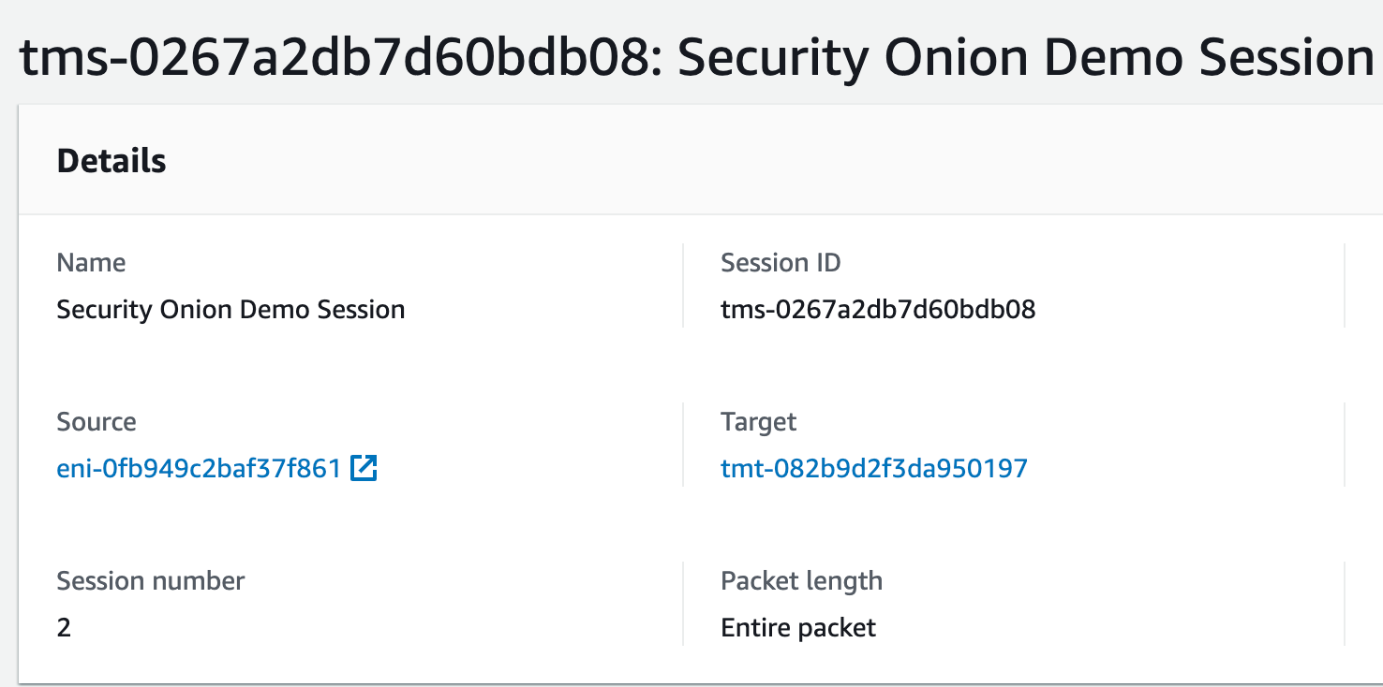
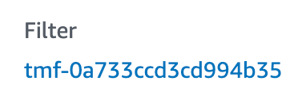
AWS – Traffic Mirror Session
Mirror Session is comprised of:
Source interface (to be mirrored)
Target Interface
Mirror Filter

Slide 28
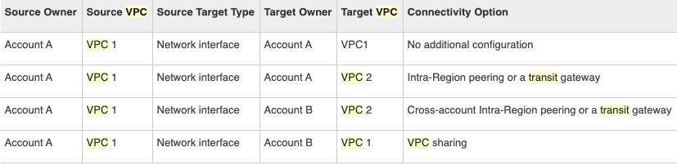
AWS - Cross-Account/Cross-VPC Mirroring

Slide 29
To the Console!

Slide 30
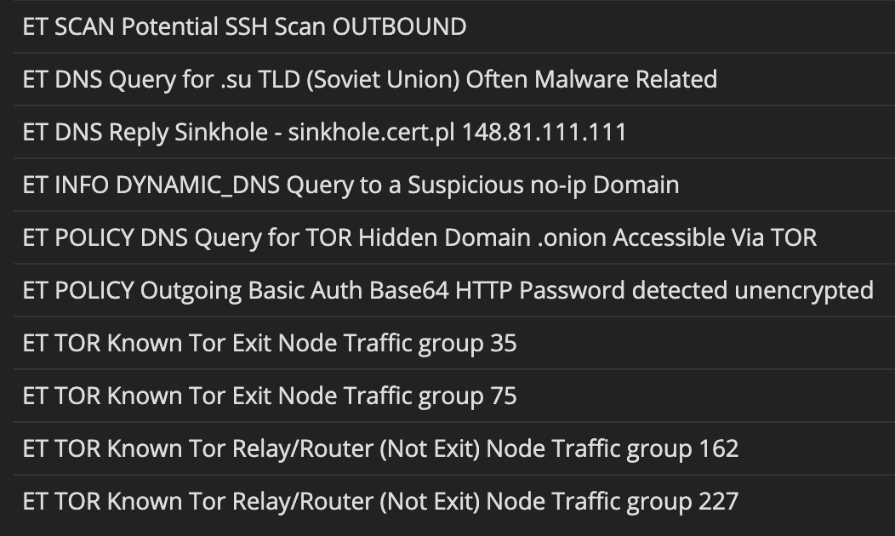
tmNIDS
Open-source
Written by Tiago Faria, 3CoreSec (0xtf)
Test alerting for cloud or on-premises NSM
quickly and easily

Slide 31
3CS AutoMirror
Open-source
AWS Lambda function/serverless app
Quickly and easily facilitate cloud NSM
Monitors EC2 instances
If instances created with Mirror=True tag (and if instance is a supported type), their interfaces will be added to a VPC mirror session
Also works for instances that are tagged, then restarted

Slide 32


Slide 33
GCP – Native NSM Capability
Packet Mirroring
Allows for capture of the complete conversation between hosts on the network
Extremely valuable for network forensics and security monitoring, and can be relatively inexpensive to implement compared to some other methods
Can specify subnets, network tags, or instance names
https://cloud.google.com/vpc/docs/packet-mirroring

Slide 34
GCP – Key Considerations
You can mirror only TCP, UDP, and ICMP traffic.
Mirrored sources and collector destination must be in the same region (can be in different VPCs w/ VPC Network Peering)
Max number of mirror sources:
5 subnets
5 tags
50 instances
https://cloud.google.com/vpc/docs/packet-mirroring#key_properties

Slide 35
GCP – Packet Mirroring Components
Collector
Mirrored source
Internal load balancer and forwarding rule
Packet mirroring policy
VPC Peering if across different VPCs

Slide 36
GCP - Collector
Instance(s) to which all traffic is mirrored
Can be a group of instances, or a single instance
Typically runs software that ”sniffs” the network traffic to look for anomalies
Ex. Snort/Suricata/Zeek
In our case, the collector will be a Security Onion instance.
https://cloud.google.com/vpc/docs/using-packet-mirroring

Slide 37
GCP – Mirrored Source
The interface(s)/instance(s) for which traffic will be mirrored
Can be defined based off of:
Subnets
Tags
Name of instance(s)
https://cloud.google.com/vpc/docs/using-packet-mirroring

Slide 38
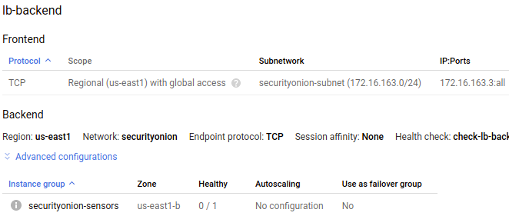
GCP – Internal Load Balancer
Allows for routing of traffic from mirrored instances to collector instances behind the load balancer
Must be in the same region as the instances to be mirrored
Collector destination specified as an associated forwarding rule
https://cloud.google.com/vpc/docs/using-packet-mirroring#internal_load_balancer

Slide 39
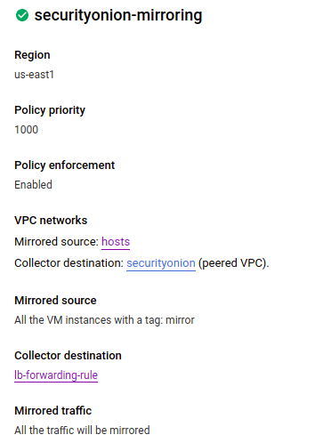
GCP – Packet Mirroring Policy
Region
Priority
VPC Networks
Mirrored Source
All VMs w/ mirror tag
Collector destination
lb-forwarding-rule
Filtering
All traffic
https://cloud.google.com/vpc/docs/using-packet-mirroring#creating

Slide 40
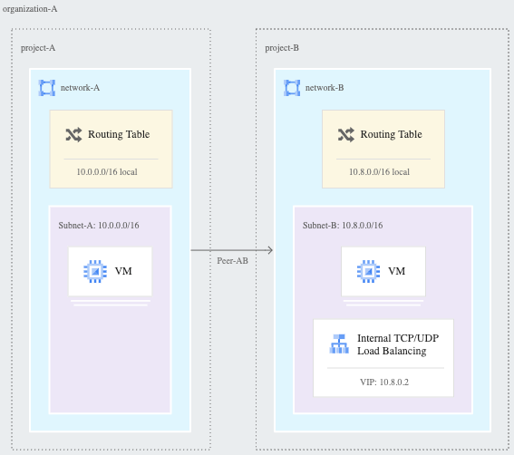
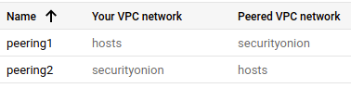
GCP – VPC Peering
Allow for cross—VPC mirroring
https://cloud.google.com/vpc/docs/using-vpc-peering

Slide 41
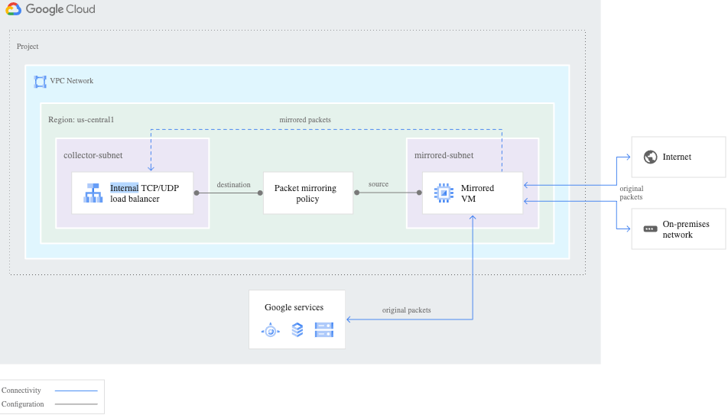
https://cloud.google.com/vpc/docs/packet-mirroring#same-network

Slide 42
Automating NSM Deployment with Terraform

Slide 43
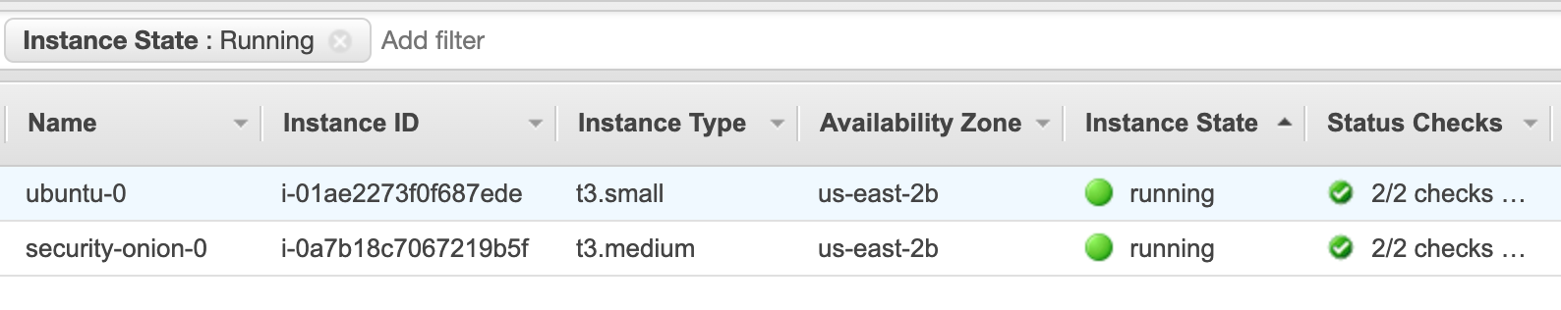
Terraform: NSM with AWS
Follow the instructions below to setup a full-fledged VPC that includes:
Security Onion
Ubuntu/Windows hosts
AutoMirror functionality to automatically mirror the traffic for each of the hosts
https://github.com/Security-Onion-Solutions/securityonion-cloud/tree/master/terraform

Slide 44
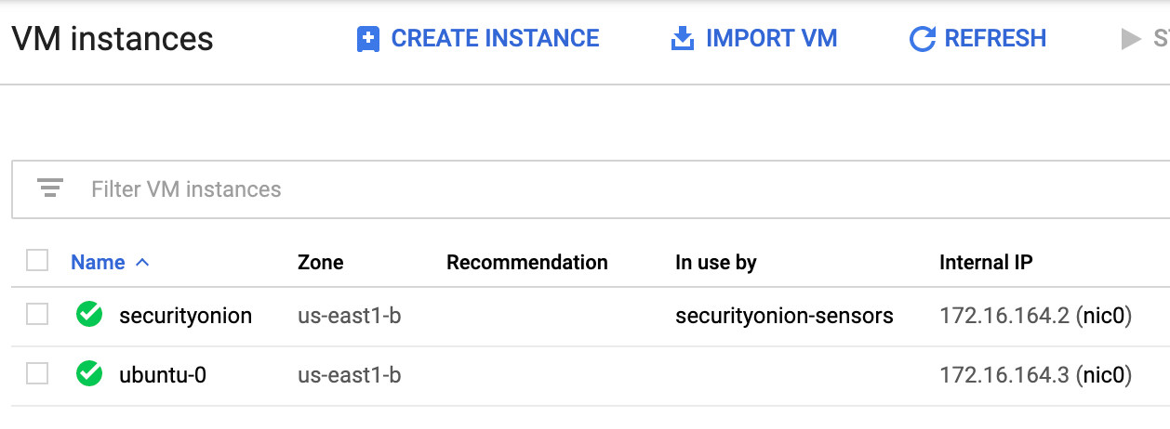
Terraform: NSM with GCP
https://github.com/Security-Onion-Solutions/securityonion-cloud/tree/master/terraform/gcp

Slide 45
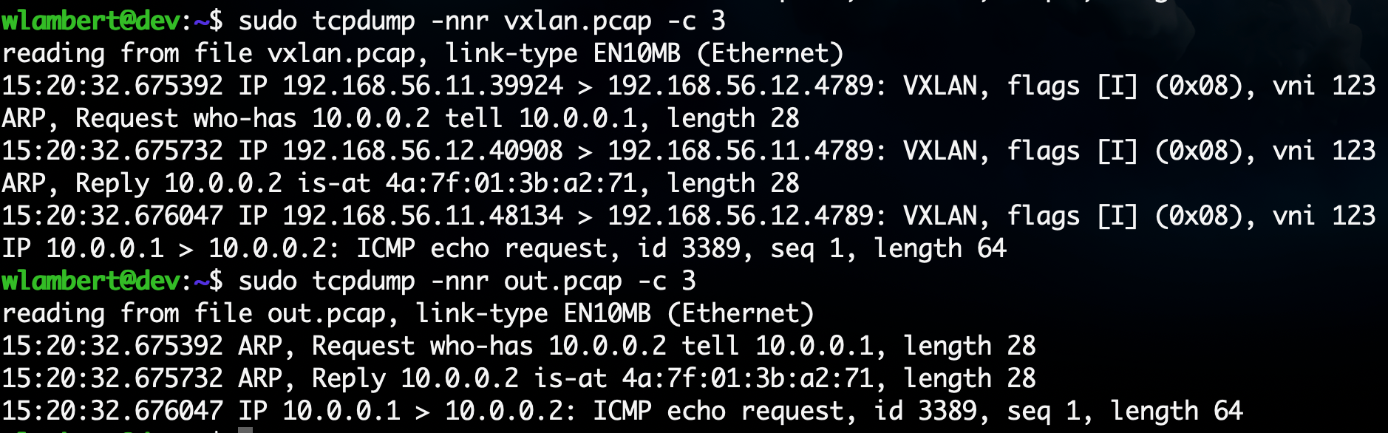
vxlan2pcap
Convert VXLAN-encapsulated PCAP to be readable by tools not supporting VXLAN encapsulation:
./vxlan2pcap vxlan.pcap out.pcap
https://github.com/Security-Onion-Solutions/securityonion-cloud/tree/dev/vxlan2pcap

Slide 46
FIN
@therealwlambert
@securityonion
Download Security Onion
http://securityonion.net
Download the RC1 Release of Security Onion 2.0
Ubuntu 8/Centos 7
Includes Sigma, Playbook, osquery, TheHive, Cortex, and more!
https://github.com/Security-Onion-Solutions/securityonion
Documentation:
https://securityonion.readthedocs.io
Professional Services, Training, and Support
https://securityonionsolutions.com
NSM Resources
Applied Network Security Monitoring – Chris Sanders, Jason Smith
Practice of Network Security Monitoring – Richard Betjlich

